Slide 1
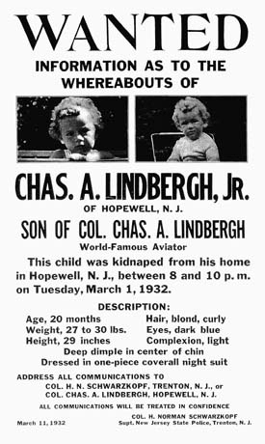
Lindbergh kidnapping

Slide 2
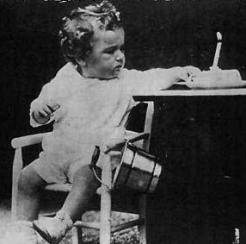
1st birthday

Slide 3
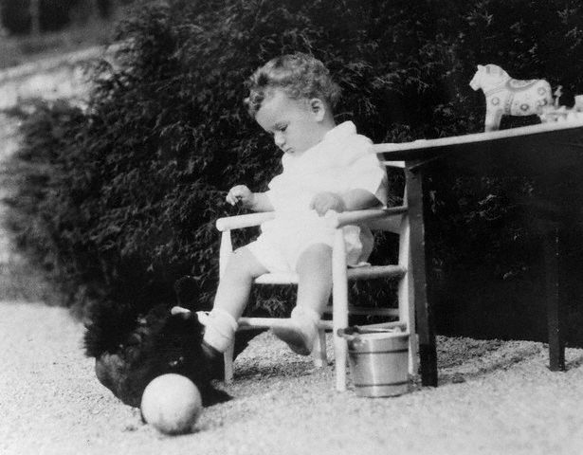

Slide 4
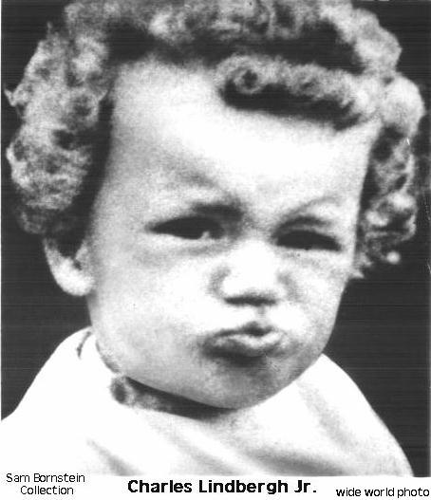

Slide 5
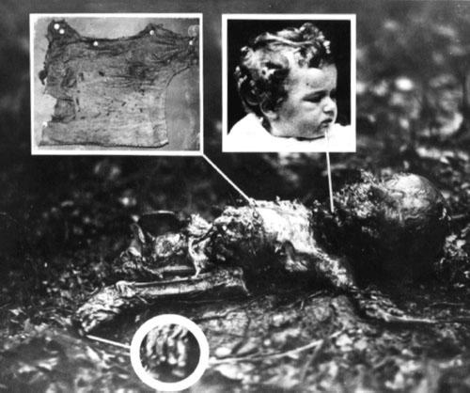

Slide 6
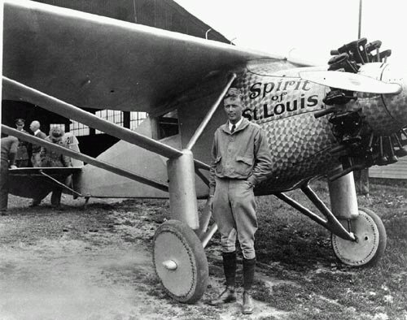

Slide 7
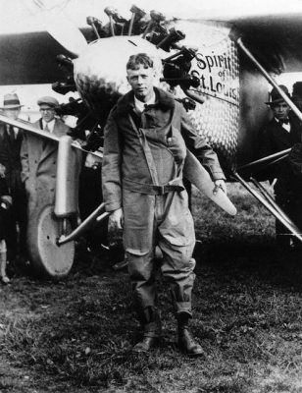

Slide 8
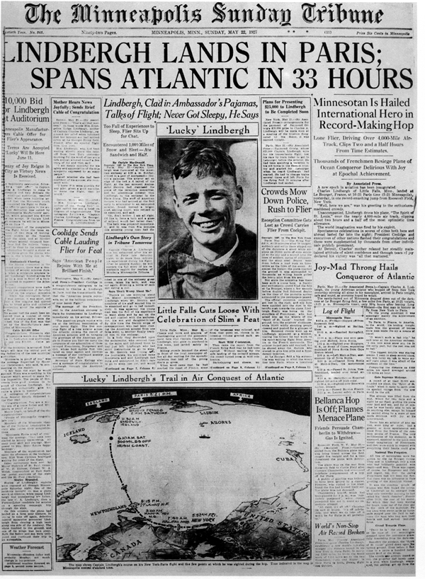

Slide 9
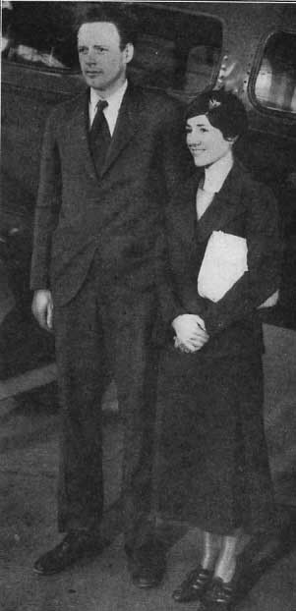

Slide 10
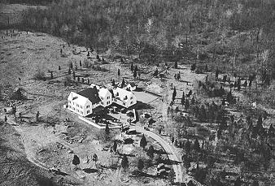
Hopewell, NJ

Slide 11
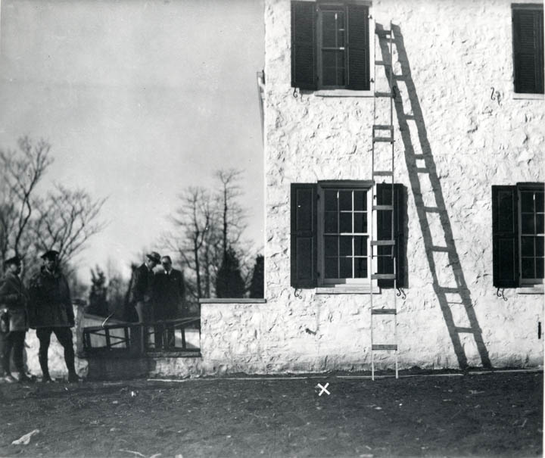

Slide 12
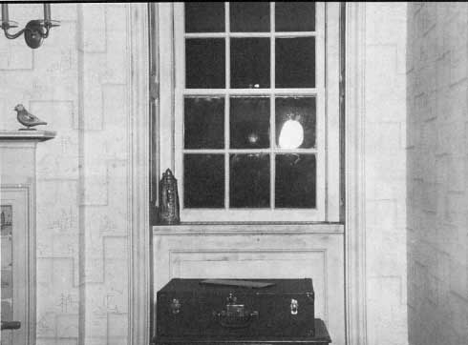

Slide 13
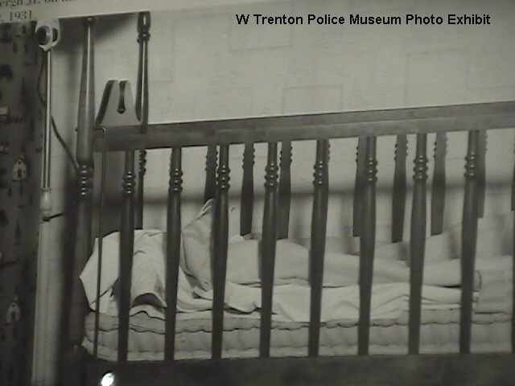

Slide 14
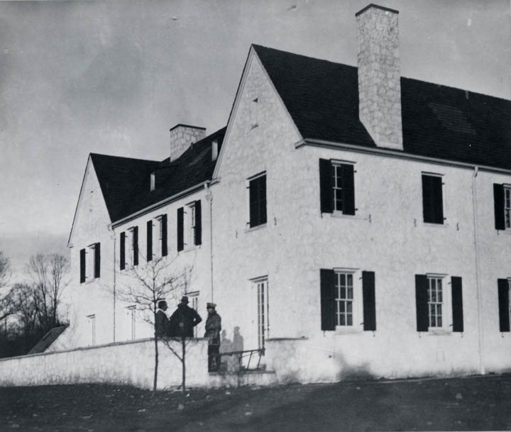
9:00 heard noise like crate falling in kitchen – regretted never following-up

Slide 15
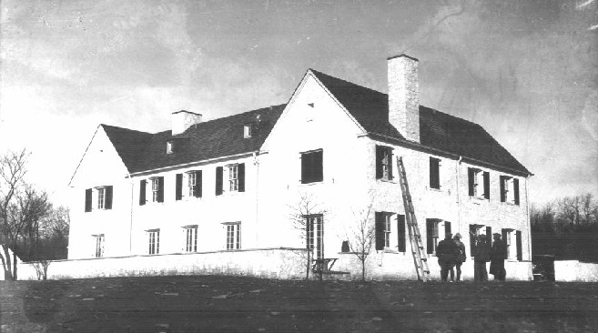

Slide 16
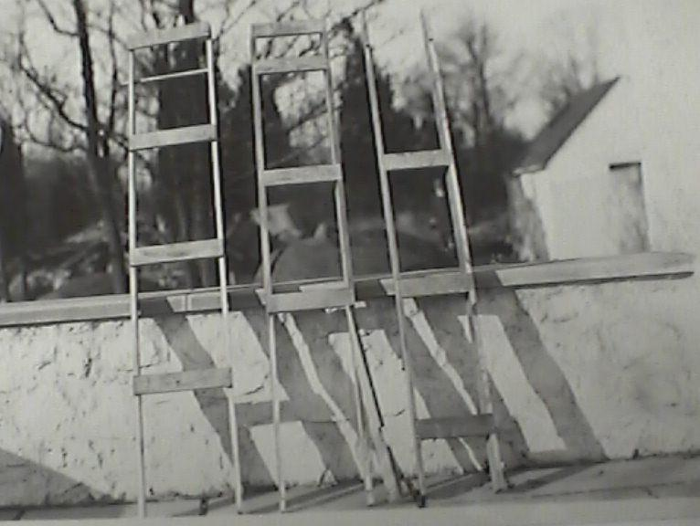

Slide 17
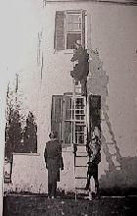

Slide 18
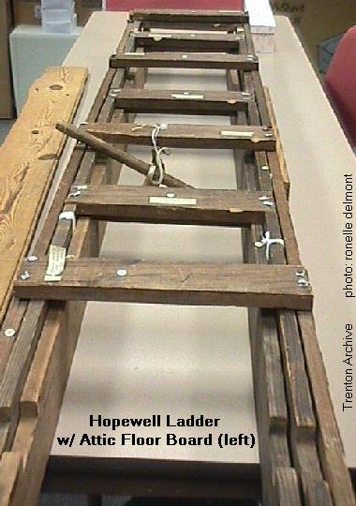

Slide 19
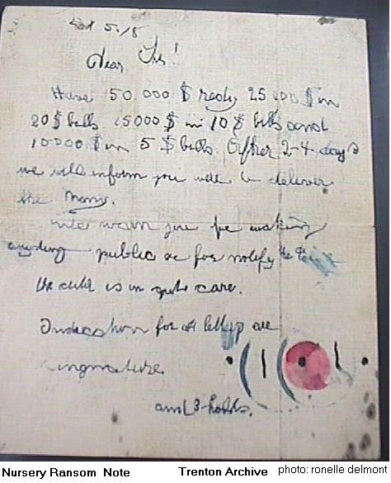

Slide 20
What is spelled wrong?

Slide 21
Lindbergh Kidnapping- Now a federal offense to kidnap

Slide 22
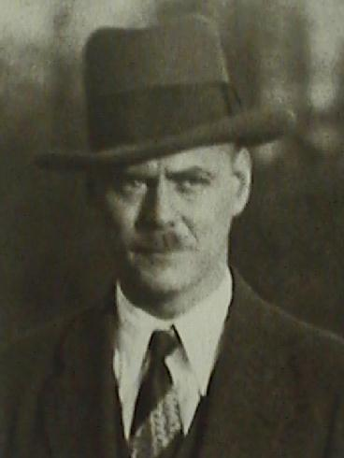
Schwarzkopf

Slide 23
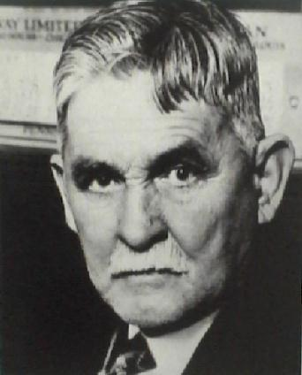
Condon
Wacko??

Slide 24
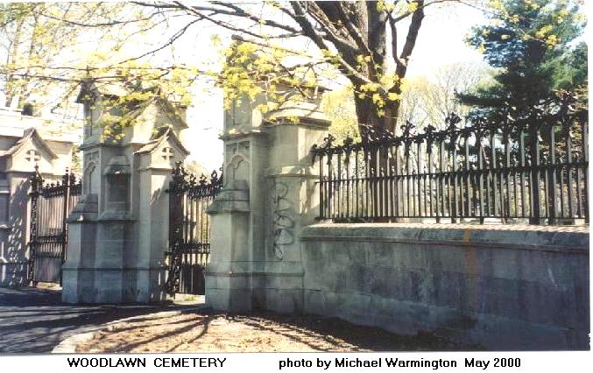
The man expressed to Condon the fear that he "might even burn." Alarmed, Condon asked him what he meant. "What if the baby is dead?" he asked. "Would I burn if the baby is dead?" Condon, blood rushing to his face, demanded to know why he was asked to deliver a ransom if the baby was dead. "The baby is not dead," the man said. "Tell the Colonel not to worry. The baby is all right."

Slide 25
Coat lapels pulled over lower portion of face

Slide 26
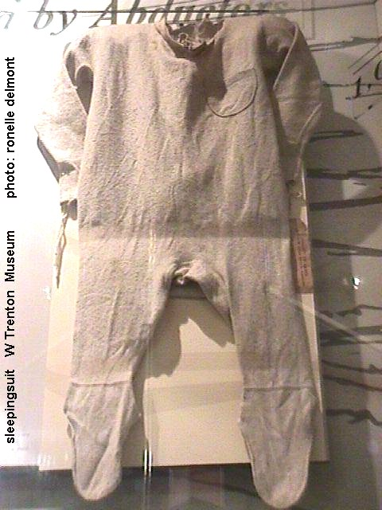
Sleeping suit mailed to prove had the baby

Slide 27
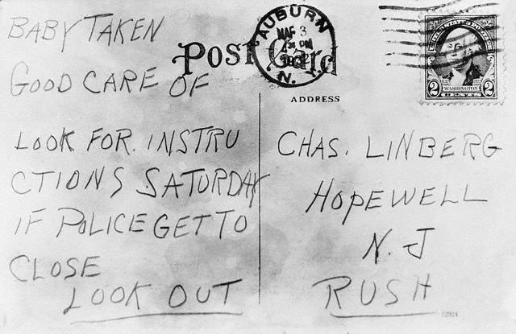

Slide 28
Kidnapper paid taxi driver to deliver letter to Condon
Taxi driver later picked him out of a lineup

Slide 29
Did not hide face
St. Raymond's, the Bronx
The second meeting with "John" occurred at St. Raymond's Cemetery in the Bronx. This time Dr. Condon was driven to the cemetery by Charles Lindbergh. Dr. Condon told Lindbergh to stay in the car (it was parked half a block away) with the ransom money. This would be Condon's 2nd meeting with "John".
(The Lindberghs would eventually name their second child Jon. It is difficult to understand. Anne gave birth only 5 months after Cemetery "John's" involvement in the extortion plot.)

Slide 30
Payoff
The $20,000 envelope had large $50 bills which would be easy to trace
Condon did not know!!!!!!!!!!!!!!!!!!

Slide 31
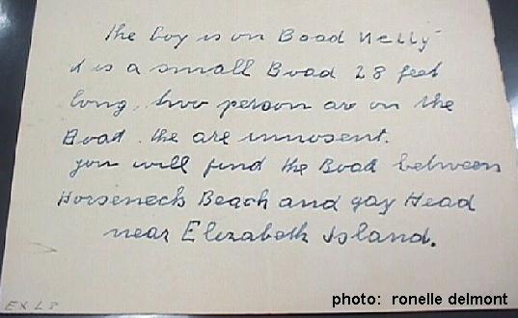
“it is a small Boad 28 feet long, two person are on the Boad. the are innosent. you will find the Boad between Horseneck Beach and Gay Head near Elizabeth Island”

Slide 32
“We’ve been double crossed”
Search for boat: Nothing!!

Slide 33
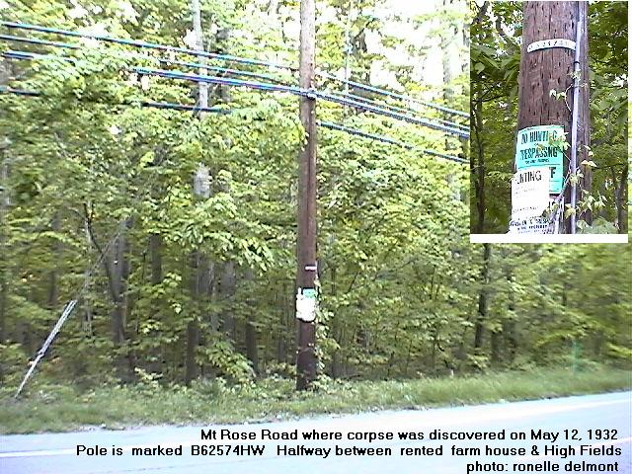
1st Huge Break in Case
Hot
Dogs
Peanuts
Popcorn
Postcards

Slide 34
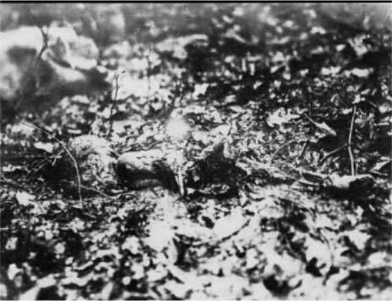
Face down so preserved

Slide 35
“By the teeth and toes, I will know”

Slide 36
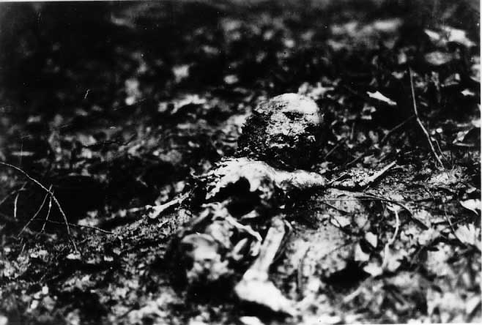

Slide 37
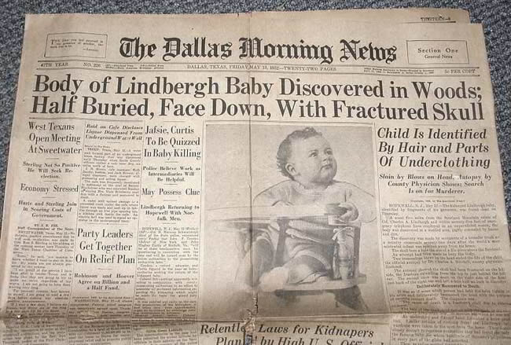
NO HANDS???????
Lindbergh????

Slide 38
In all probability, the child was choked, strangled, or smothered to death in his crib. Look at it from the kidnapper's point of view: the Lindbergh's were home, and also in the house were their three servants, including the child’s nursemaid. If the child had awakened and cried out, the kidnapper would have been trapped in the room. A quick escape down the rickety ladder was not possible. From the kidnapper's point of view, not killing the child would have been too risky. Some have suggested that the child had been chloroformed, but this is unlikely because the odor would have lingered, and there was no evidence of it.

Slide 39
Baby cremated: worried about grave robbers!

Slide 40
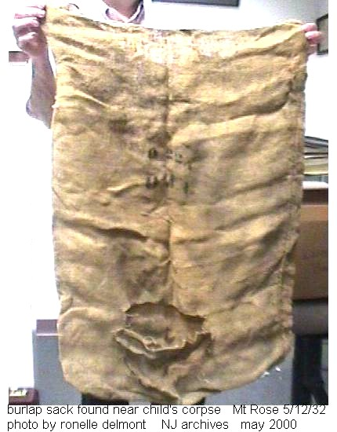

Slide 41
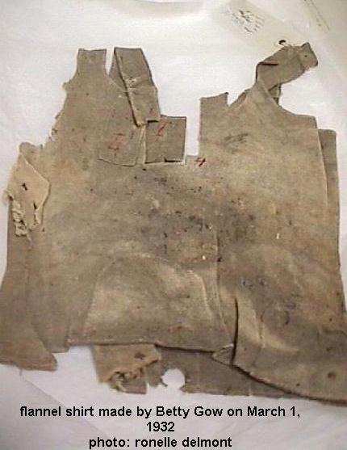
Found on the baby

Slide 42
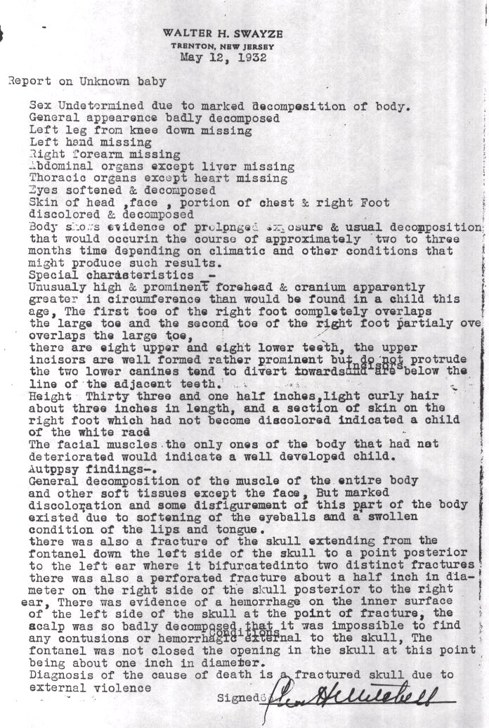

Slide 44
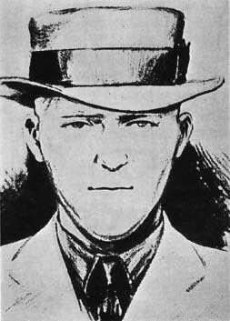
"Cemetery John" - Sketch of the supposed kidnapper, prepared by the Department of Justice early in 1934, from composite description by Dr. Condon (Jafsie) and Joseph Perrone, the cab driver who delivered a note from the kidnapper to Condon. (International News Photo)

Slide 45
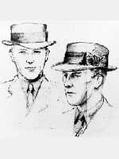

Slide 46
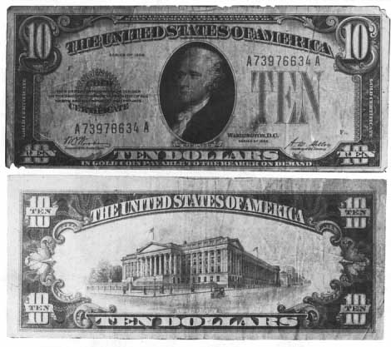
Gas Station - 1934
“I only have a 100 of them left”

Slide 47
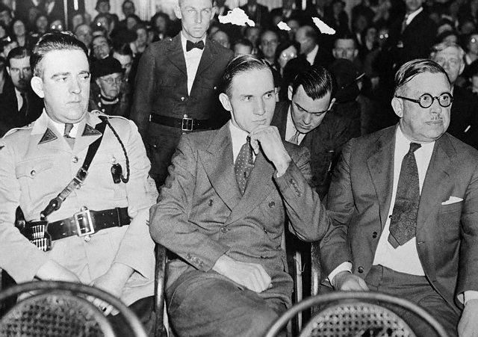

Slide 48
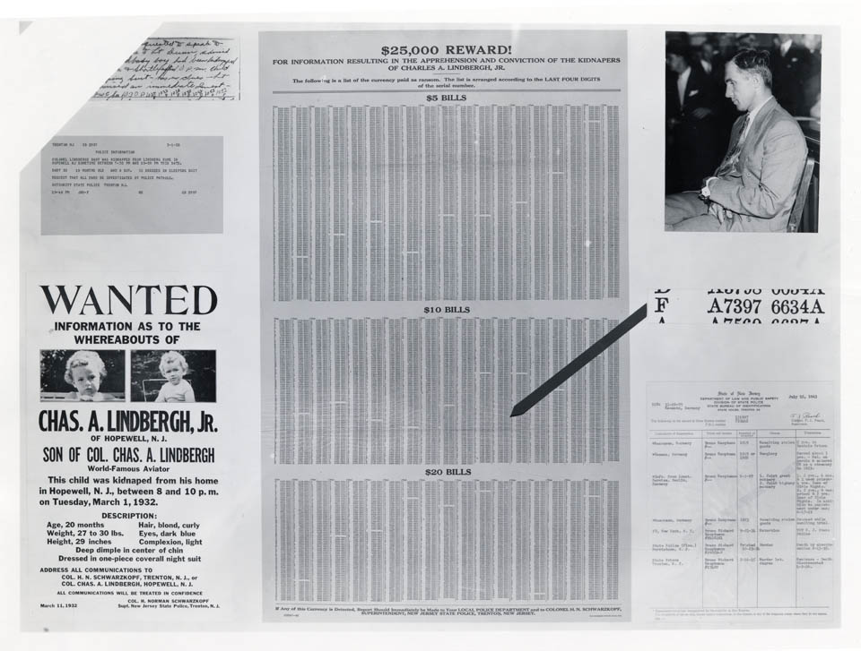

Slide 49
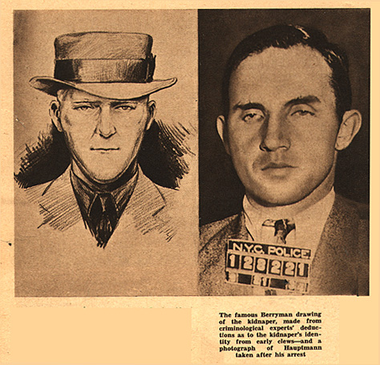

Slide 50
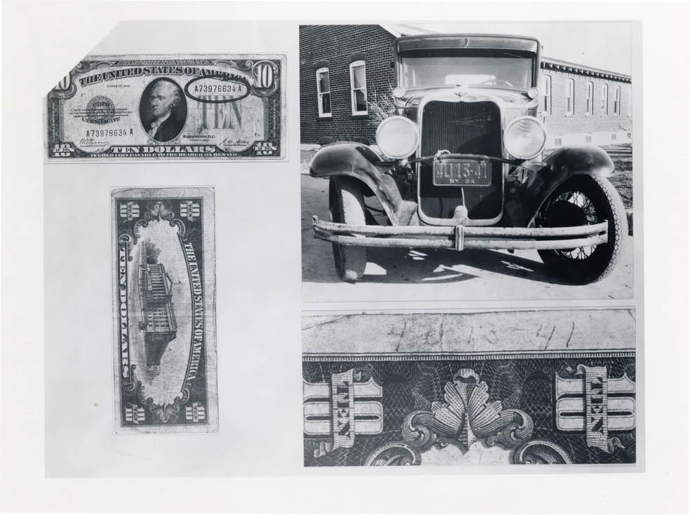

Slide 51
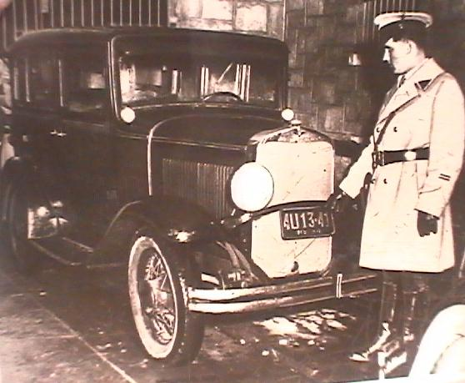

Slide 52
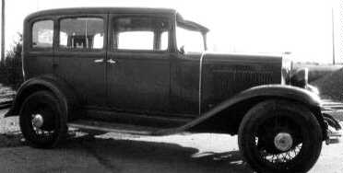
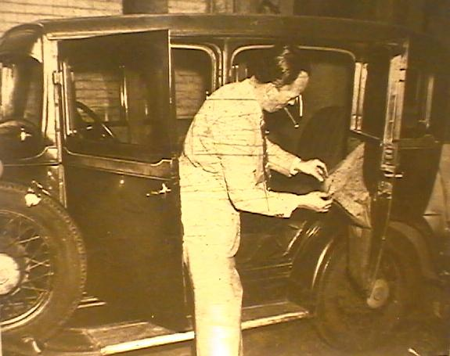

Slide 53
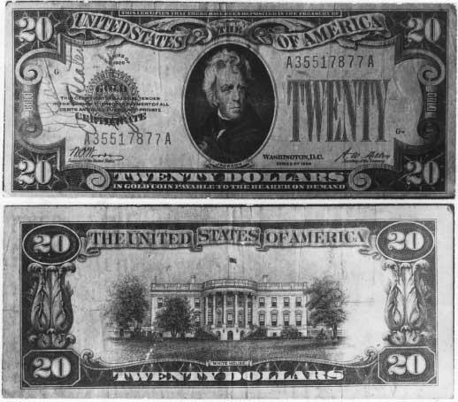
When arrested in wallet

Slide 54
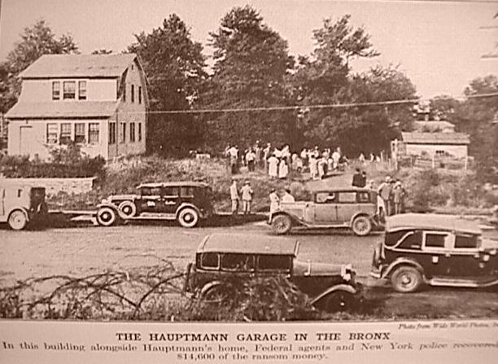

Slide 55
When questioned in the house, Hauptmann kept looking out the window to the garage

Slide 56
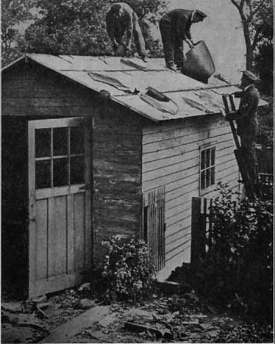

Slide 57
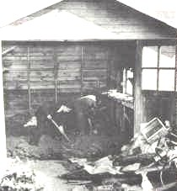

Slide 58
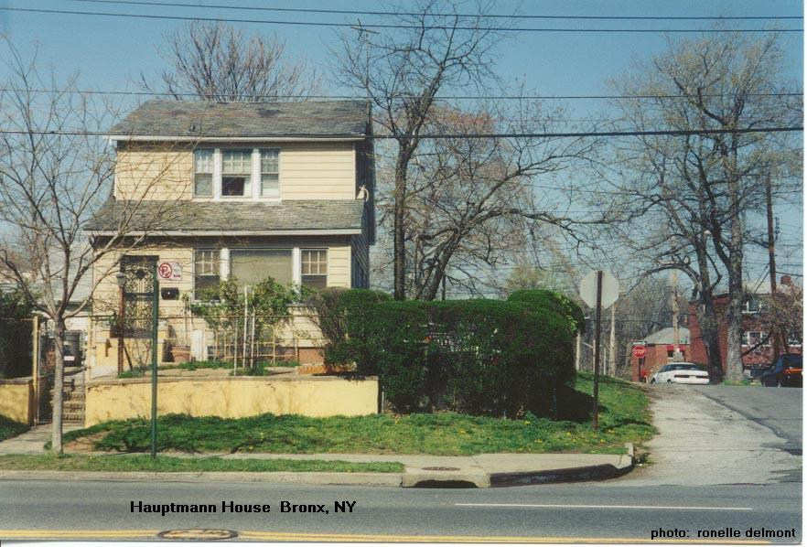

Slide 59
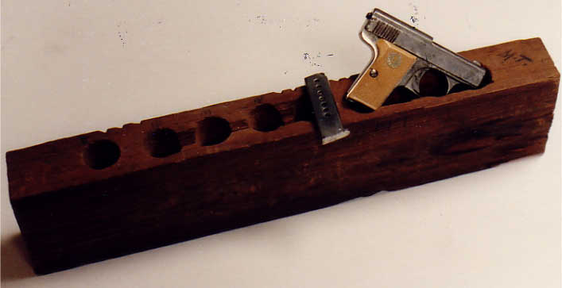
A two-by-four was found wedged between two wall joists in Hauptmann's garage. The board had six holes drilled into it, five of the holes contained ransom money and the sixth, larger hole, contained a tiny, silver-colored pistol with a white plastic grip.

Slide 60
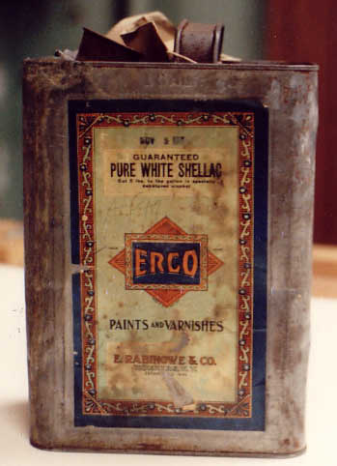
One-gallon shellac can found hidden in Hauptmann's garage containing $11,930 in ten and twenty dollar ransom bills.

Slide 61
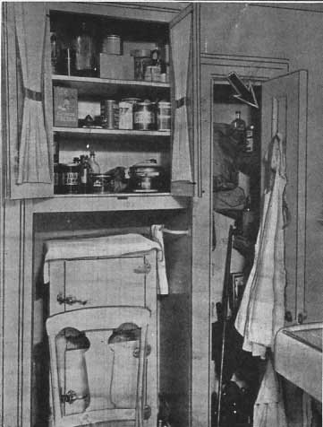
Site of box from Fisch according to Hauptmann
Wife never saw it!

Slide 62
Money Trail (NY Times)
Credit balance under his name $886
Credit balance under wife’s maiden $5017
Joint account $2,578
2 mortages on houses in brooklyn $7,000
Ransom money in garage $14,590
2 loans to Fisch $7,500
Ransom money in circulation $5,100
Lost in stocks $7,000
Total: $49,761

Slide 63


Slide 64

Said he was never arrested in Germany
Requested writings for many, many hours

Slide 65



Slide 66


Slide 67


Slide 68


Slide 69


Slide 70

Schwarzkopf
And
Lindbergh

Slide 71


Slide 72


Slide 73


Slide 74


Slide 75


Slide 76


Slide 77


Slide 78

Koehler

Slide 79

Ladder rail had 4 holes not connected to ladder
Nail holes matched up to beams

Slide 80


Slide 81


Slide 82


Slide 83


Slide 84

Comparison of wood grain in ladder rail #16 and attic floorboard, with overlay showing artisti's rendering of missing piece

Slide 85


Slide 86



Slide 87

Wood plane belonging to Hauptmann; comparison of plane markings in ladder rails and rungs

Slide 88


Slide 89


Slide 90

Drawing from Hauptmann’s
home
Claims a visiting child drew it

Slide 91
X =
Site
of
chisel

Slide 92

Chisel found outside Lindbergh residence and chisel from set belonging to Hauptmann

Slide 93

Closet in Hauptmann residence in which address and telephone number of J. F. Condon were found written on wall

Slide 94


Slide 95
Let's look at Foley's interview in NY...
Q: [Foley] Hauptman, I want to ask you some questions about this board you know it is from your closet in your own house, don't you?
A: [Hauptmann] It must be.
Q: It is the same kind of wood - your handwriting is on it?
A: Yes, all over it.
Q: What did you write on that board, read it to the stenographer.
A: I can't read it any more.
Q: Who rubbed it out? Can you read the address on it?
A: 2974. I can't make out the first. I read the number down below, 37154.
Q: What else can you read on that board that you wrote yourself?
A: I can't read - that is "a", "t", "u" and a "r". Another one I can't make out.
Q: That's Dr. Condon's address isn't it?
A: I don't know.
Q: Why did you write it on the board?
A: I must have read it in the paper about the story. I was a little bit interested and keep a little bit record of it, and maybe I was just on the closet, and was reading the paper and put it down the address.
Q: How did you come to put the telephone number there?
A: I can't give you any explanation about the telephone number.
Q: Your only explanation for writing Dr. Condon's address on this board, and telephone number, is that you were probably reading the paper in the closet and you marked it down, is that correct?
A: It is possible that a shelf or two shelfs in the closet and after a while I put new papers always on the closet, and we just got the paper where this case was in, and I followed the story of course, and I put the address on there.
Q: That's why you marked it on the door?
A: That's the only explanation I can give.

Slide 96


Slide 97


Slide 98




Slide 99


Slide 100


Slide 101


Slide 102
Stopped working the day of the pay-off
Hadn’t worked as a carpenter for 2.5 years
Friends on breadlines, but Hauptmanns living comfortably
Was paying rent with gold certificates

Slide 103
Germany (Hauptmann: an upstanding citizen?)
1) Broke into mayor’s house with ladder (2nd story)
2) Stole groceries from 2 women pushing strollers
3) Arrested for more burglaries
Escaped from prison
Escaped from police van
Stowaway to America

Slide 104

Numerous witnesses identified him in New Jersey!
Woman id’d him spending money at movie theater before he claimed Fisch gave him the money
8 handwriting experts = Hauptmann’s writing
His x’s were 2 “e”s
$44,486
Words in ledger spelled like ransom (boad)

Slide 105
Undisputed Evidence
Fourteen thousand dollars of the ransom money was found hidden in his garage after he told the police he didn't have it.
Most of the ransom bills were spent in the Bronx and North Manhattan, not far from Hauptmann's home.
The wooden kidnap ladder was homemade. It came in three pieces and when compressed fit across the inside of Hauptmann's car. it was crude but ingenious and light enough for one man to carry. Hauptmann was a carpenter by trade and one of the boards in the ladder had been purchased at a building supply store close to his house.
Hauptmann didn't earn a wage from April 1932 (the month the ransom was paid) until his arrest in September, 1934. During this period, amid the Great Depression, he had purchased new furniture, several guns, expensive clothes, and had sent his wife to Germany. When arrested, he was wearing a homemade suit of fine material. By his own admission, he had invested $15,000 in the stock market. He had also alarmed his garage.
Some of the ransom letters had been mailed from New York City, and the Lindbergh intermediary, John F. Condon, met twice with the kidnapper in Bronx cemetery.
The physical description of the man in the cemetery, as given by John Condon after the meeting, matched Hauptmann almost perfectly. Condon said the man had a German accent, and Hauptmann was a German, having come to America as a stow-a-way in 1923.
In Germany, Hauptmann had served five years in prison for burglary and robbery. He also had a record of escape, and had fled to America to avoid being sent back to prison. His criminal record is glossed over by those who support him.
In his notebooks, and in his other writings unrelated to the case, Hauptmann had misspelled words the same way they had been misspelled by the writer of the ransom notes. Examples include New-York and singnature.
In one of Hauptmann’s notebooks, the police found a sketch of a ladder segment that matches the design and construction of the kidnap ladder. There was also a drawing of a window.

Slide 106
Questioned Documents
The most damaging evidence against Hauptmann, the handwriting evidence is only disputed by Hauptmann's most zealous supporters. An unbiased analysis of this evidence by those familiar with the science of questioned documents leaves no doubt that Hauptmann had written all fourteen of the ransom notes. The evidence is as follows:
At Hauptmann's trial, eight of the world's most prominent handwriting experts, including Albert S. Osborn, the virtual father of the science, testified that all of the ransom documents, as well as the address on the package that contained the baby's sleeping suit mailed to Colonel Lindbergh, had been written by Hauptmann.
Four rebuttal handwriting experts would have testified for the prosecution but were not needed.
Although he wasn't needed at the trial, the head of the FBI crime lab examined the ransom notes, and at a grand jury hearing in 1934, testified that Hauptmann was the ransom note writer.
Two handwriting experts who had been asked to look at the questioned documents evidence on behalf of Hauptmann could not help the defense because “they found Hauptmann to be the ransom writer.”
Three of the so-called experts for the defense were not put on the stand by Hauptmann's attorney because of their opinion that the ransom letters had been altered by the police to match Hauptmann's sample writings. This was so absurd it would embarrass the defense.
The lone handwriting witness that did testify for the defense was clearly unqualified.
At least six modern-day handwriting experts have reexamined the questioned documents evidence. They all agree that Hauptmann was the ransom note writer.

Slide 107
Hauptmann is connected to the kidnap ladder in the following ways:
Rail 16 of the ladder had once been a floor plank in the attic of his house. It would have been impossible for the police or the prosecution to have fabricated this evidence.
The kidnap ladder contained marks made by some of Hauptmann's carpenter tools.
Nails found in Hauptmann's garage were made at the same place and time as those in the kidnap ladder.
A piece of the ladder was traced to a store in Hauptmann's neighborhood.

Slide 108
Hauptmann quit his job on the day of the ransom payment!!!

Slide 109
Lone Wolf?
The evidence:
Hauptmann had either spent or stashed the entire amount of the ransom payment. If there were accomplices, they did it for nothing.
After Hauptmann's arrest, no more ransom bills turned up in circulation.
In Germany, when Hauptmann used a ladder to burglarize a home, he acted alone.
In the ransom negotiations, the kidnapper, who called himself “John,” agreed on the spot to a $20,000 reduction in the extortion payment. If there had been accomplices he may not have had this authority

Slide 110



Slide 111
Bruno Hauptmann never changed his plea of not guilty to the murder of the child. He was offered a last minute change of sentence to life imprisonment to confess to the murder, but refused. He was also offered 90,000 US dollars (USD) to confess by a newspaper. This was a huge sum at the time, which could have been used to take care of Hauptmann’s wife and child after his death, but Hauptmann would not change his plea and claimed he would not plead guilty to a crime he had not committed.

Slide 112
Elliott's description of the last moments of Hauptmann is vivid, and conjures up a scene that is gripping.
"His head, which had been shaved, titled slightly to one side. His face was yellow; his features were drawn. He glanced neither to the right nor to the left. He walked past the chair, and would have collided with a physician had not a guard stopped him. The guard turned him around, and maneuvered him to the chair. He gripped its broad arms with his hands, staring straight ahead as he was strapped in. His lips did not move, and he gave no indication that he wished to speak. I placed the head electrode on him, and helped to adjust the mask. At precisely 8:44 o'clock, I was given the signal. The current streaked through the condemned man."
So ended the story of the man convicted of "the Crime of the Century."

Slide 113



Reporter, Sam Blackman, described the execution in an article about the case (Feb 9 1992) for the LA Times.
"There were 55 witnesses in the execution chamber when Hauptmann, accompanied
by two clergymen, came in at 8:41 p.m. Robert H. Elliott, the gray-haired
executioner, spun a wheel three times. Six doctors applied stethoscopes. Then
Dr. Howard Weisler, the prison physician, said: "This man is dead." It was 8:47 1/2 p.m."
A large crowd stood outside the prison in Trenton anxiously awaiting word of his death and cheering during the execution. The next day, when the hearse carried Hauptmann's corpse away, a massive crowd stood by yelling and cheering.

Slide 114

How can this conclusively solve the case?

Slide 115
In December 2002, Mike Holfeld, an investigative reporter with WKMG in Orlando, attempted to have several of the Lindbergh ransom envelopes tested for traces of saliva DNA. These envelopes, from the 1930s Lindbergh kidnapping investigation, are perfect saliva samples because each one of them had been opened with a knife along the edges. The glued flaps are still, after 72 years, neatly affixed to their surfaces.

Slide 116


Slide 117
Richard Sloan's Annual 2009 Bronx Tour
SAT. MAY 16, 2009
10:15 AM - 4:45 PM rain or shine
NEXT ANNUAL BRONX LINDBERGH KIDNAPPING
BUS TOUR FOR MAY 16 th HAS EXCLUSIVE VIDEO
Saturday, May 16th, is the date that a luxury tour bus will once again serve as the time capsule that transports twenty-three passengers back in time to a most controversial chapter in American history -- the search for the Lindbergh baby and his kidnapper.

